Slide 1

The Talking Mailbox
LoRa-Enabled Post Detection System
By Abhinav Kothari and Justin Chin Cheong

Slide 2

Problem
Professors/Instructors have a lot to do, and don’t always have the time to see the mailbox
Checking for mailbox and finding nothing can be annoying and waste of time
Unchecked post for long time if professor busy
No way of knowing if post received if away

Slide 3



Solution: The Talking Mailbox
Check post
Your mailbox knows when something arrives
Pressure sensor to detect post in box
Same sensor can detect when post is removed
Notify
The mailbox talks to you
Update a website to see if post is in the box
Optional: mail the respective person
Alert
Stay alert
Monitors battery and alerts user in case of low battery
Detects opening, and alerts user: avoid tampering

Slide 4
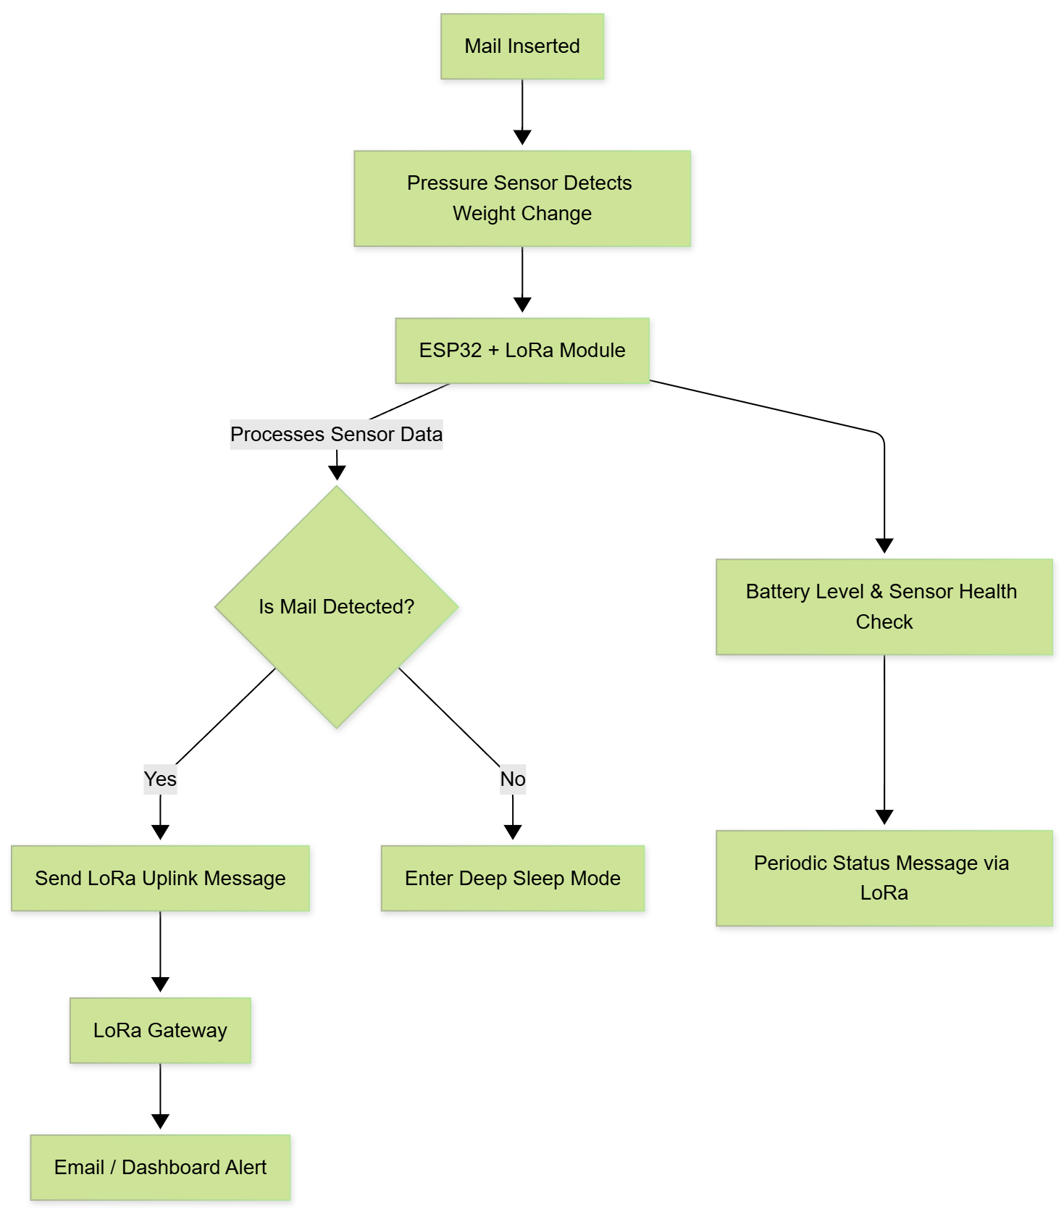
Approach to Solution
Check for post
Detect
opening
Use a pressure sensor to detect if a post comes in
A combination of Light Dependent Resistor and Tilt Sensor on the lid to detect opening
Notify personnel
Monitor
battery
Detecting post triggers LoRaWAN gateway notification (website/mail)
Check voltage levels, in case it drops below a threshold, alert the user

Slide 5







Product technologies and interaction
Weight
Sensor
Website/Mail
LDR
WiFi LoRa Heltec
LoRa Antenna
Backend Layer
Legend Communication
Wired
LoRaWAN
Internal server
Tilt Sensor

Slide 6
Thank You
Any questions?

Slide 7
Functional Requirements
For the The Talking Door to be a satisfiable product, the following functional requirements must be implemented:
It can detect if a mail is in the mailbox
It can detect if the mailbox is opened
It can check the battery status
It can communicate if a mail is in the box to a website (based on LoRaWAN)
It can detect light as a redundancy for confirming the opening status of the mailbox
It alerts the responsible person via email or dashboard upon mail detection

Slide 8
Technical Requirements
For the The Talking Door to operate and perform its functions, the following technical requirements must be implemented:
The pressure sensor can detect when a piece of mail has been placed within the box
The tilt sensor can detect the rotation of the post box lid hence detecting if it opened
The LDR can detect the change in light intensity when the lid is opened
The transmitter can reliably connect and communicate via the LoRaWAN
The server the LoRaWAN communicates too can notify the personnel about the mail
The power supply is a battery with a working voltage of 3.3V to 5.5V
The enclosure can protect the system within a typical indoor environment (IP 31)
Should function at temperatures ranging 0-40°C and humidity 10-90%

Slide 9
Attribution Links
Some icons were used from flaticons, here are the attribution links:
https://www.flaticon.com/free-icons/light-dependent-resistor : Light dependent resistor icons created by verluk – Flaticon
https://www.flaticon.com/free-icons/antenna : Antenna icons created by Freepik – Flaticon
https://www.flaticon.com/free-icons/spirit-level : Spirit level icons created by juicy_fish - Flaticon

Slide 10
Price Estimates
Estimates
Weight Sensor : 20.00 euros
RBS311104: Digital Tilt Sensor : 3.00 euros
ESP 32 Heltec : 32 euros
PDV-P9203 : LDR : 0.88 euros
Housing estimate : 20 euros (extreme case)

